Slide 1


Slide 2
Something
and a little bit of something else

Slide 3

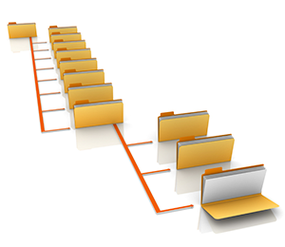
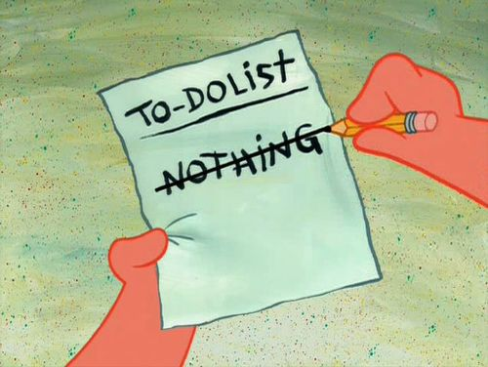
Agenda

Slide 4
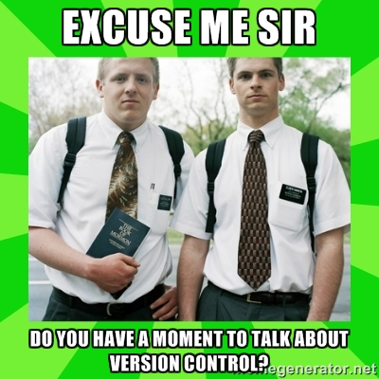

Slide 5
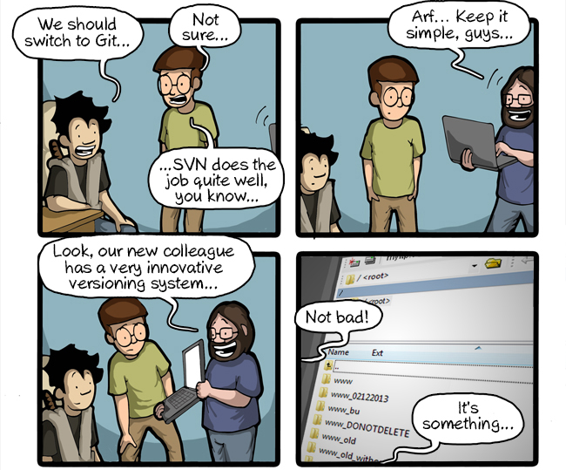
Why Git?

Slide 6
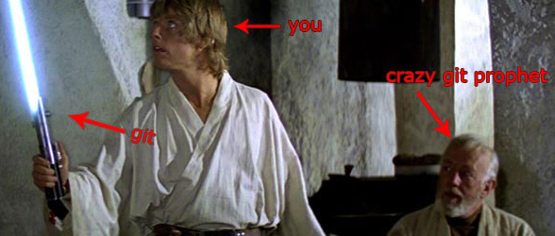
WTF is Git?

Slide 7


Slide 8
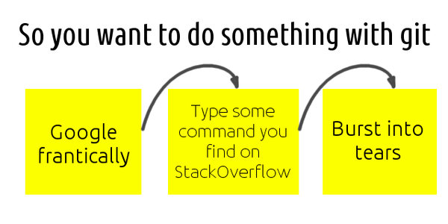
Git: HOWTO

Slide 9
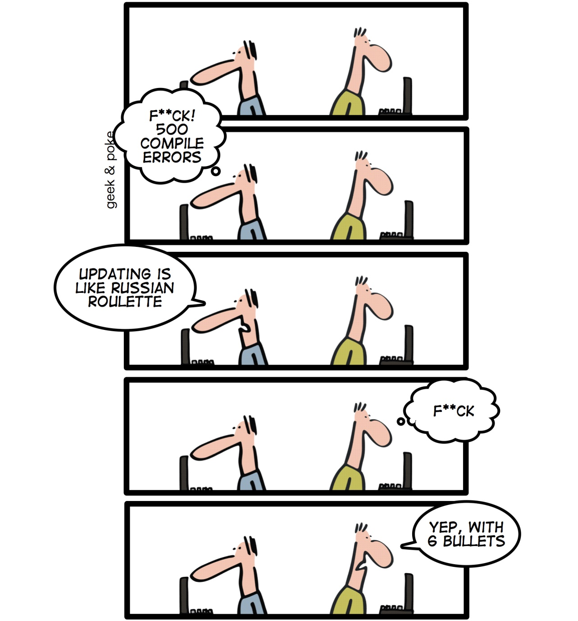
Update First

Slide 10
Commit often
Commit!
Implemented a feature?
Fixed a bug?
Refactored a function?
Wrote a comment?
Compiled a project?
Gotta pee?
Commit!
Commit!
Commit!
Commit!
Commit!
As soon as you can describe your achievement with a sentence -- COMMIT

Slide 11
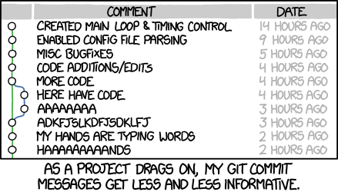
Commit messages

Slide 12
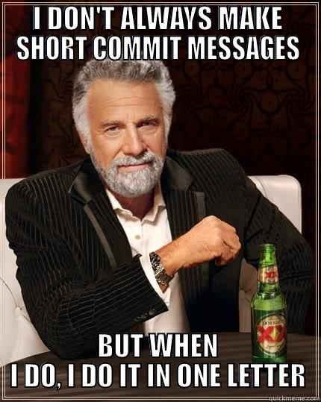
Commit messages
And more on

Slide 13
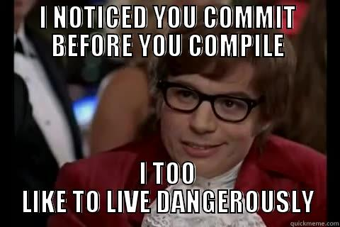
Push working code

Slide 14
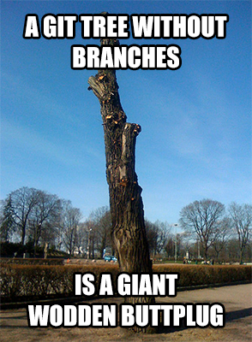
Git: Branching

Slide 15
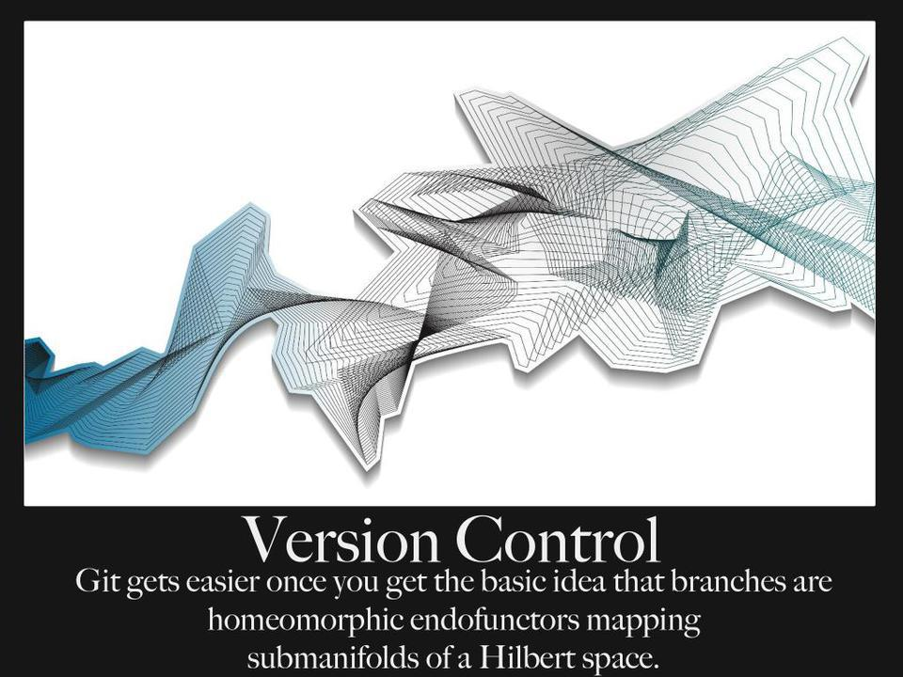

Slide 16
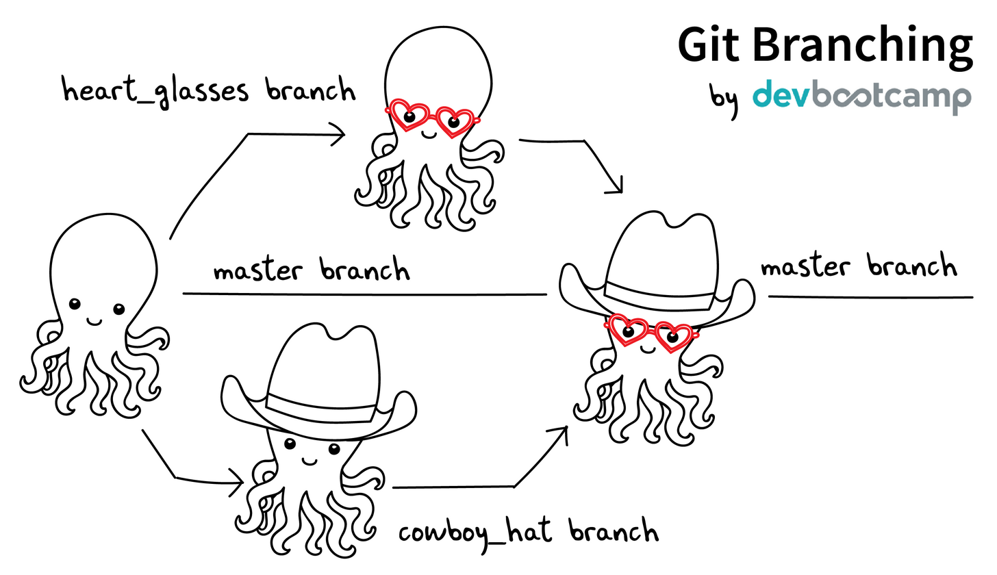
Git branching: explained

Slide 17
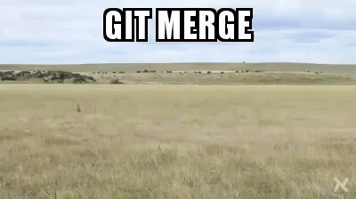
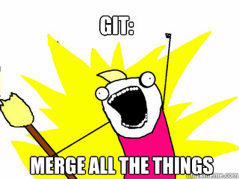
So, you have to merge

Slide 18
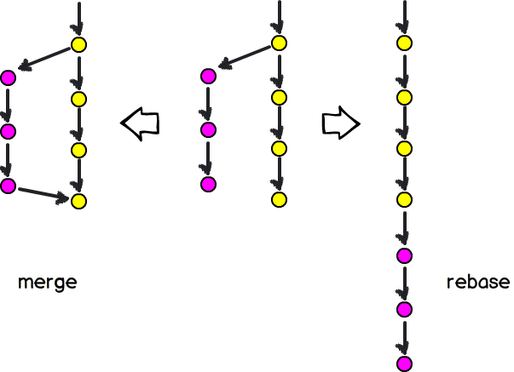
… or rebase?

Slide 19


So you have a stash…

Slide 20


Slide 21
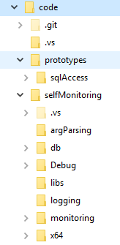
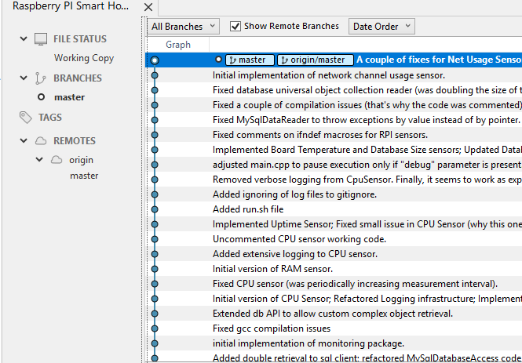
Single-dev

Slide 22
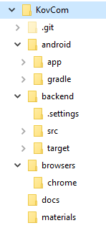
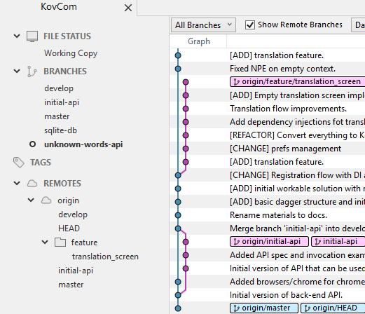
Small diverse project

Slide 23
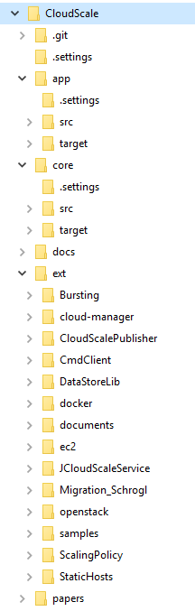
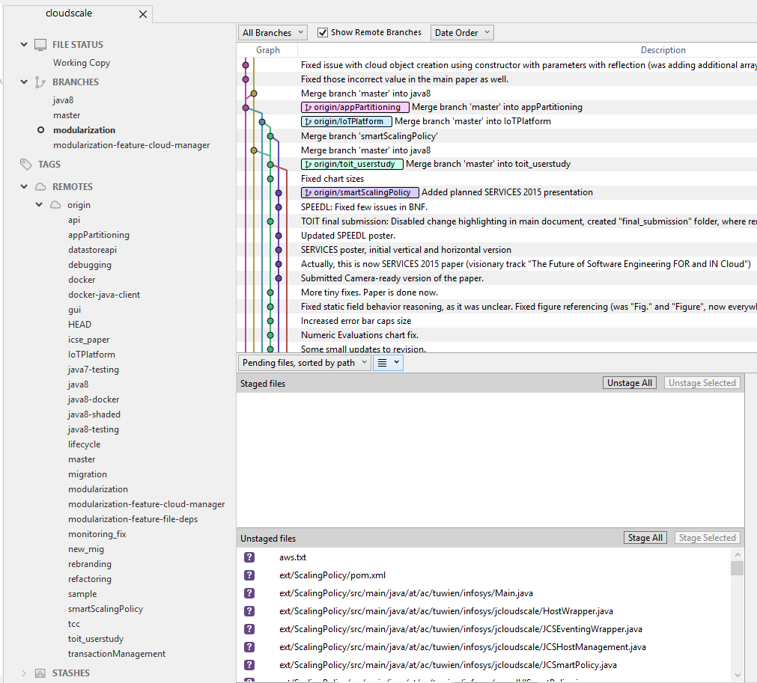

Slide 24
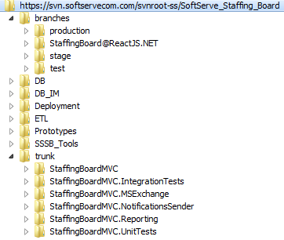
Current Project

Slide 25
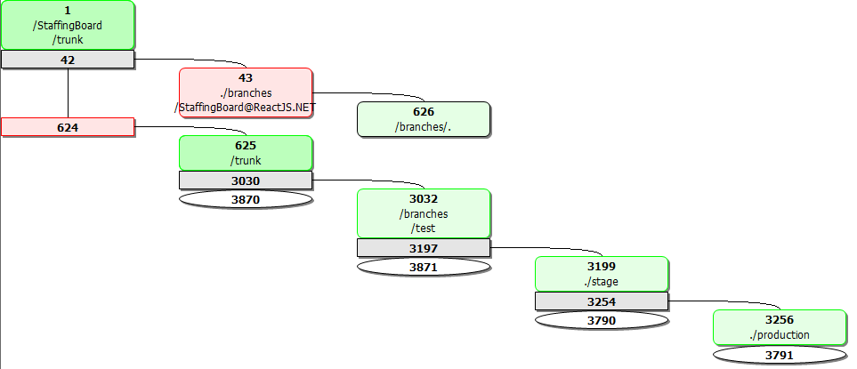
Current Project
https://trunkbaseddevelopment.com/

Slide 26
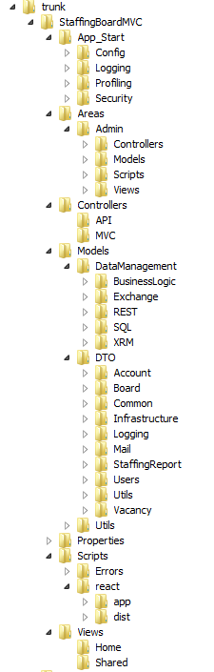
Current Project

Slide 27
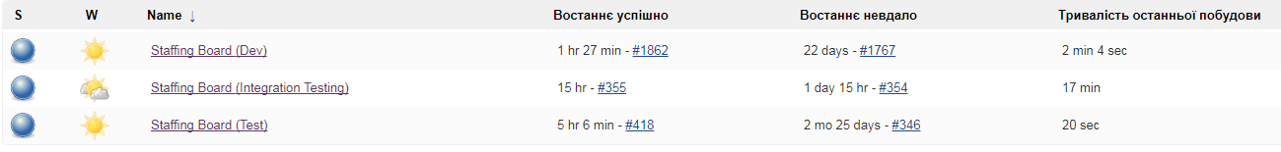
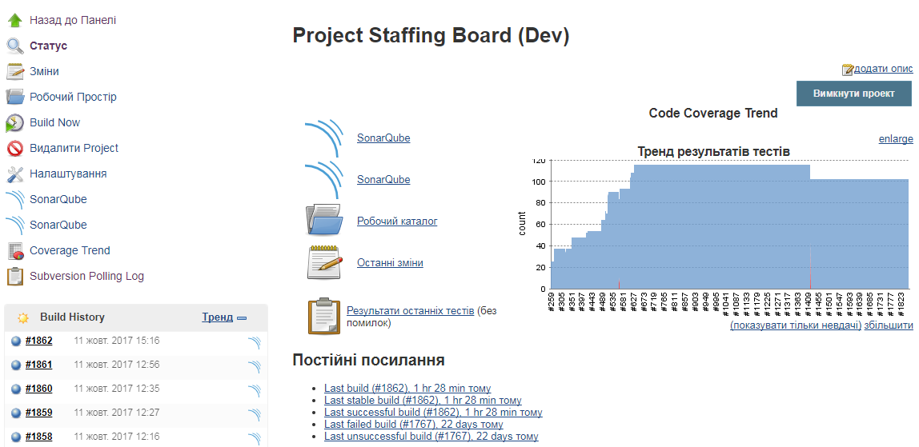
Current Project: Jenkins

Slide 28
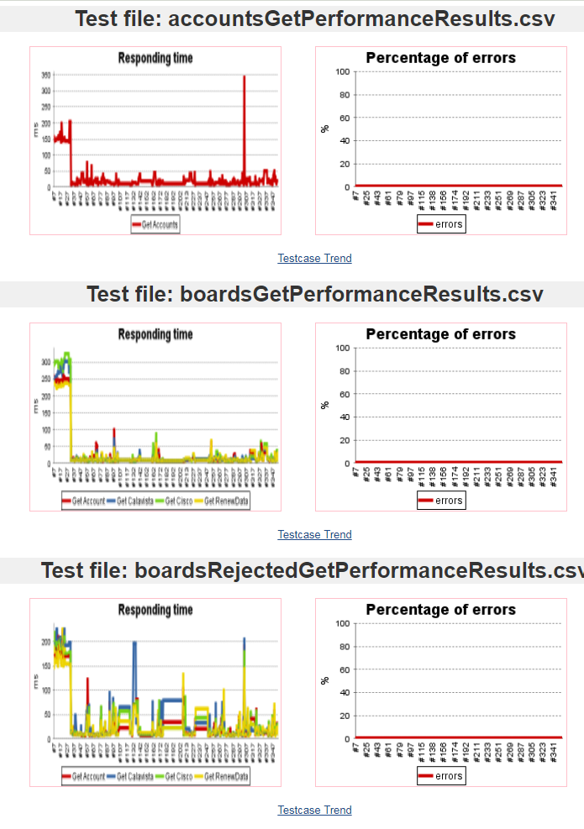
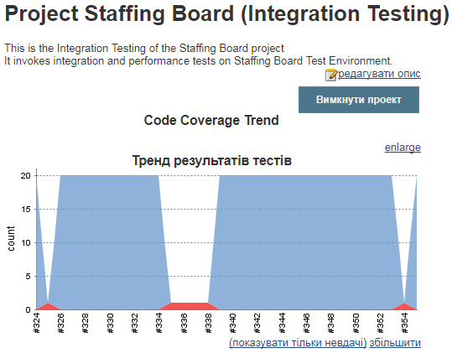
Current Project: Jenkins

Slide 29
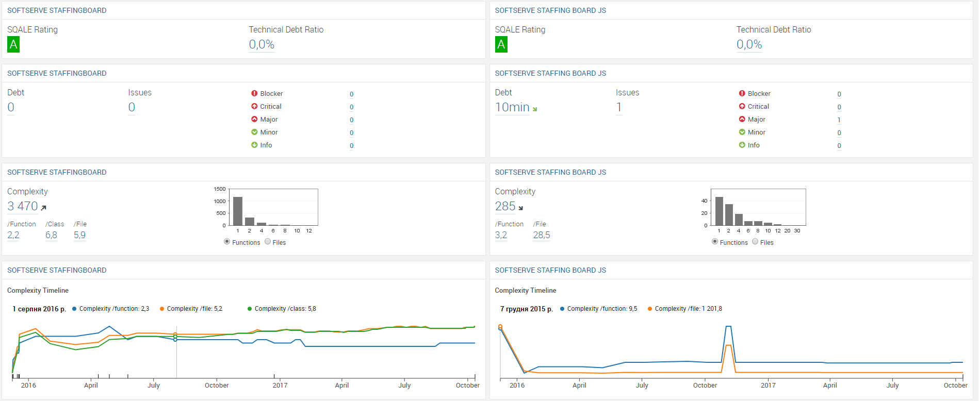
Current Project: SonarQube

Slide 30
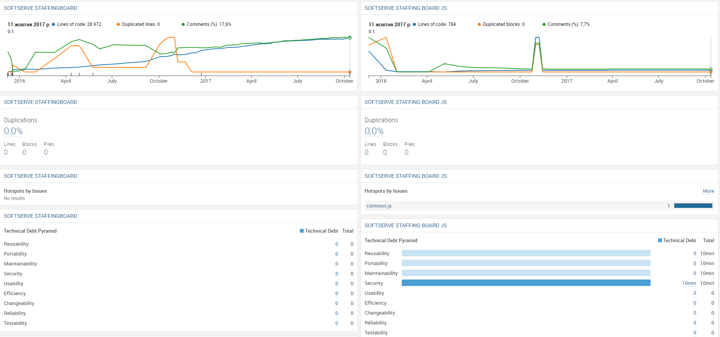
Current Project: SonarQube

Slide 31
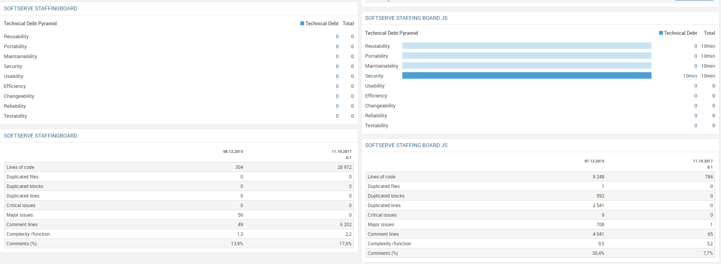
Current Project: SonarQube

Slide 32
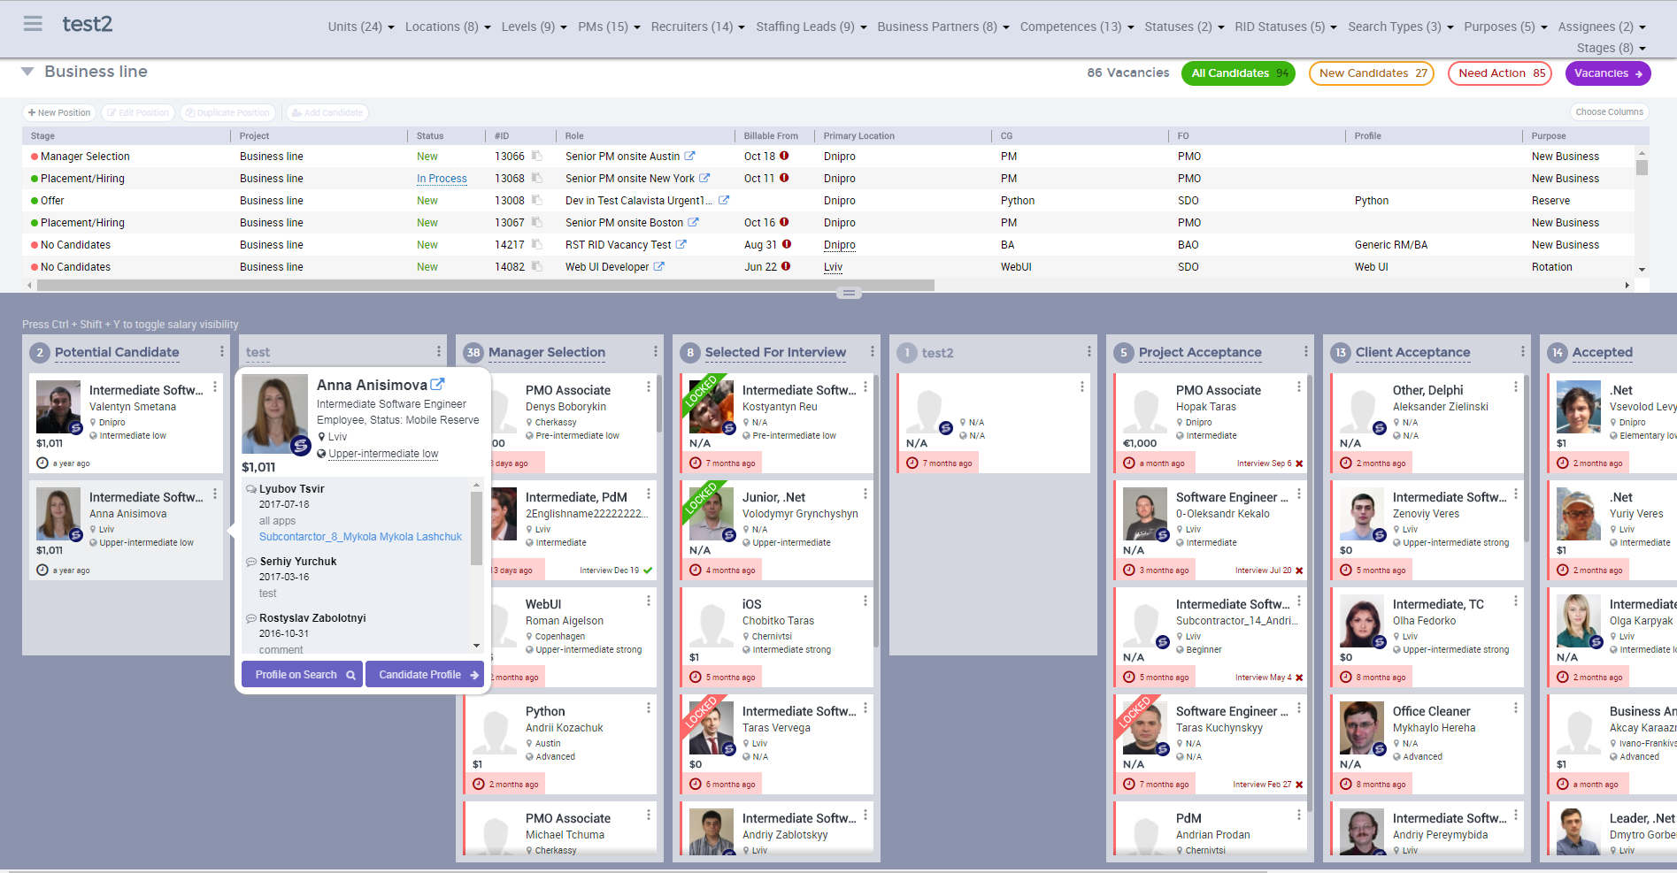
Current Project

Slide 33


Slide 34
Next steps
Define repo structure
Design delivery process
Theory gaps:
.NET app execution model
Exceptions & exception handling
Attributes & Reflection
Patterns

Slide 35


